Slide 1

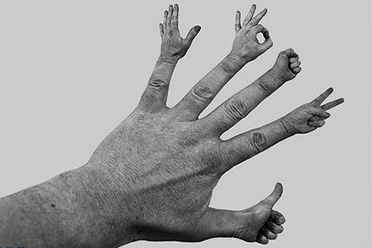
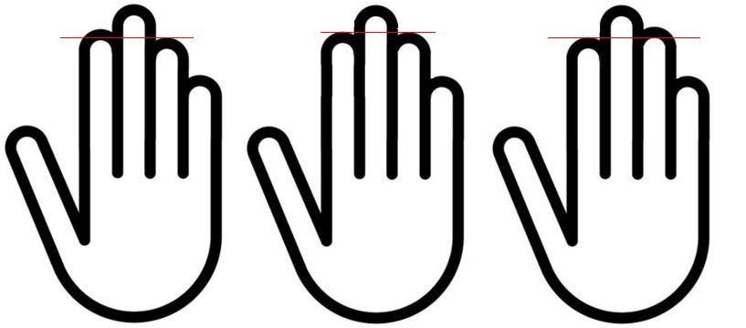
Prediction
Of fertiliy
With
Finger Length
Dr Muhammad M El Hennawy
Ob/gyn Consultant
Rass el barr –dumyat - egypt
www.mmhennawy. co.nr
www.mmhennawy. 8m.com

Slide 2

In spite that this lecture contains some medical evident informations
If you accept this lecture ,
take it as a sciense
If you do not accept it,
take it as a fun

Slide 3
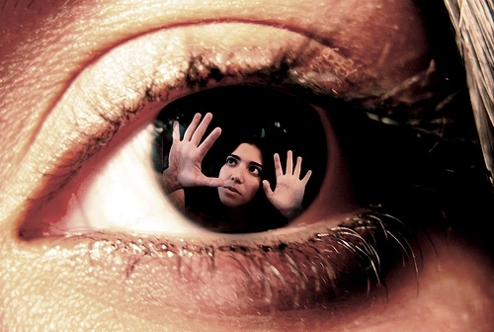
Attention
There is
an exception
for
every rule

Slide 4
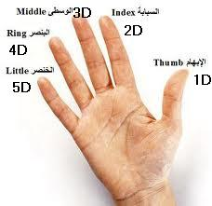

Slide 5
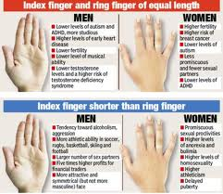
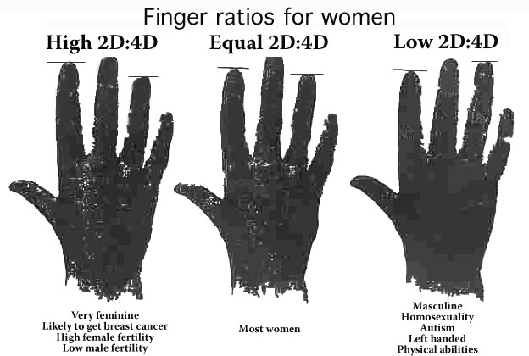
The scientists notice
The index finger is long , relative to ring finger length:
Women have higher fertility, more modest, more sensitive, relatively easy to breast cancer, do not love to take risks;
Male fertility is weak, verbal ability, attack weak, poor sense of direction .
The ring finger is long , relative to index finger length:
Female fertility is relatively weak, over-confident, relatively less likely to develop breast cancer, loves to take risks;
Male fertility ability, verbal ability is weak, attack power, good at math, more likely to suffer with autism.

Slide 6
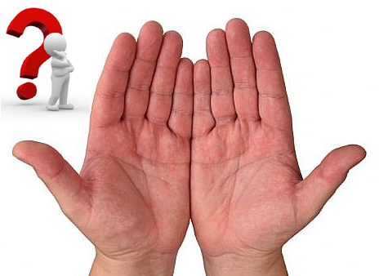
The scientists Measured The Hands Of Both Men And Women Who Went To A Fertility Clinic.
Men with symmetrical hands, or hands equal in shape and size, tended to have higher sperm counts, while men with asymmetrical hands tended to have fewer, more sluggish sperm.
What’s more, men with ring fingers considerably longer than their index fingers had more testosterone than those with short ring fingers.
Women with longer index fingers had more estrogen and other reproductive hormones.

Slide 7
Fertility
In men, a long ring finger and symmetrical hands are an indication of fertility, and that women are more likely to be fertile if they have a longer index finger.
Assortative pairing by 2D:4D, that is, a tendency of presumably high-fertility women having high 2D:4D to marry low fertility man having high 2D:4D, may have also masked the associations examined here

Slide 8
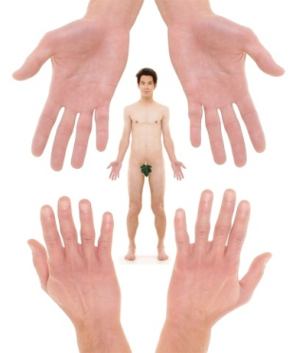
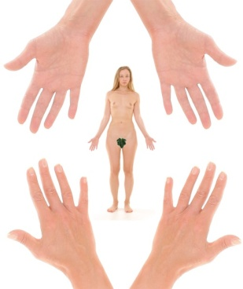
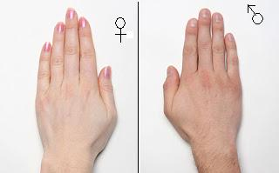
The longer fourth finger makes a man a super-stud,
While the longer second finger makes a woman super-foxy

Slide 9
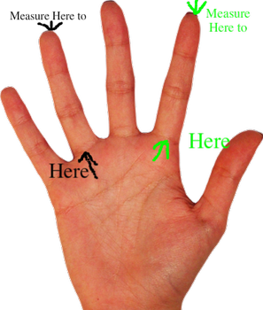
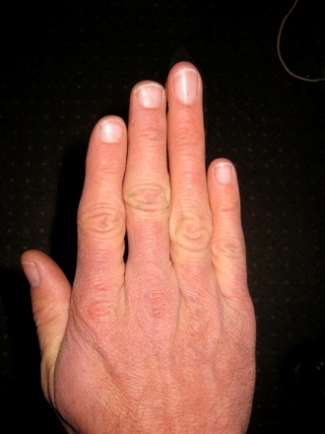
The higher the testosterone, the greater the length of the ring finger and the more "masculine" the resulting child – whether male or female.
The longest ring finger is known as the "Casanova pattern"

Slide 10
Human 2D (index) And 4D (ring) Digit Lengths:
Their Variation And Relationships During The Menstrual Cycle
Digit lengths and 2D:4D ratios offer very precise measures of greater discriminative power than 2D-4D difference or digital tip extent.
Differences in digit lengths across stages of the menstrual cycle underlines the advisability of taking the stage of the cycle into account when taking digit measurements from pre-menopausal women
The use of oral contraception are difficult to interpret fully because the use of different types of contraceptive pill could lead to different biological and confounding effects.

Slide 11
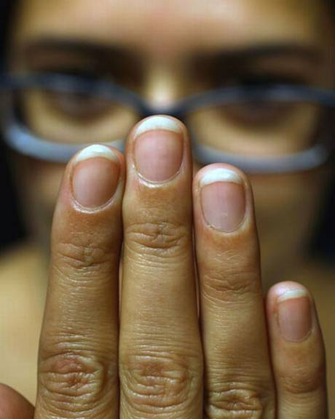
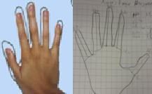
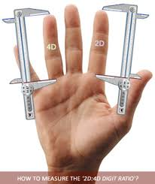
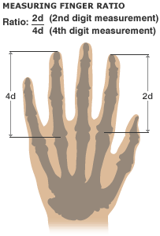
Measurement
It is difficult to measure finger length accurately.
By Placing the hand palm-down and seeing which finger extends further is a problem, because a slight shift in the angle of the fingers dramatically changes the relative position of the fingertips
hand outlines
By Measuring from from the lowest crease between finger and palm to the fingertip, is imprecise because skin moves around
By The most precise measurements come from X-rays but this is obviously impractical for classroom use.

Slide 12
Digit Ratio
Simplified,
the fourth fingers length is positively correlated to testosterone,
while the second (index) finger with estrogen.
In Europeans
2D:4D ranges between 1.0 and 0.96, with females tending towards the higher values and
males tending towards the lower.
In other populations 2D : 4D may be different.

Slide 13
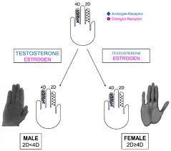
Causes
Finger length may be partially determined in the 14th week of pregnancy and is linked to levels of testosterone exposure which is, in turn, controlled by genes
During pregnancy : Digits are subtly affected by testosterone and estrogen produced in the womb by the fetus (not by the mother). Between weeks 8 and 14, tiny fetal testes, ovaries and adrenal glands secrete the baby's own supply of sex hormones. These chemical messengers, particularly testosterone, cause chain reactions in the body, spurring the growth of the genitals, encouraging and inhibiting growth in brain regions and causing changes in the fingers. (association between low 2D:4D and high levels of FT relative to FE, and high 2D:4D with low FT relative to FE ).
Genetic : both reproductive organs and digits can be affected by genes inherited from the Parent

Slide 14
Some people have an index finger that is longer than their ring finger; we'll call this long index finger (L.)
Others have an index finger that is shorter than their ring finger (S).
This is said to be a sex-influenced trait.
In males, the allele for S is said to be dominant, while the allele for L is said to be dominant in females.
Thus SS and SL males will have short index fingers and only LL males will have long index fingers,
While SS females have short index fingers and SL and LL females have long index fingers.

Slide 15
Manning’s new working hypothesis now includes e.g. the following 7 key-elements
1 – The 2D:4D digit ratio results from the balance between prental androgens testosterone & estrogen;
2 – A high 2D:4D digit ratio results from relatively low testosterone concentrations – OR relatively high estrogen concentrations;
3 – A low 2D:4D digit ratio results from relatively high testosterone concentrations – OR relatively low estrogen concentrations;
4 – The ring finger (= digit 4D) is featured with many more hormone receptors compared to the index finger (- digit 2D), therefore the 2D:4D digit ratio is mostly driven by changes in the length of the ring finger (due to prenatal hormone concentrations);
5 – Studies in human & animals indicate that the link between prenatal androgens and 2D:4D digit ratio is generally stronger for the right hand;
6 – 2D:4D Digit ratio varies with sex : males generally have longer fourth digits relative to second digits than females;
7 – 2D:4D Digit ratio varies with ethnicity.

Slide 16
vagina
Ring finger is longer than index finger --- increase T --- atrophy –short vagina -- dyspareunia
also large clitoris

Slide 17
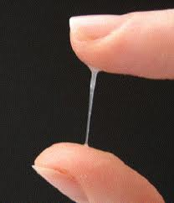
cervix
Index finger is longer than ring finger –increase E – increase mucus of cervix
Ring finger is longer than index finger –increase T -- decrease mucus of cervix

Slide 18
ovaries
Low right-hand 2D:4D ratios (but not left-hand) were associated with polycystic ovaries,
polycystic ovarian syndrome, a hormonal disorder that can disrupt fertility.
Ring finger is longer than index finger– increase T – increase polycystic ovary -- decrease ovulation
Index finger is longer than ring finger –increase E – increase ovulation

Slide 19
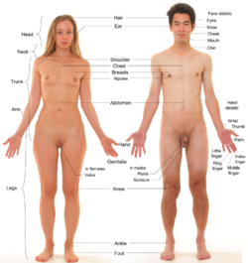
Delayed Menarche
Low right-hand 2D:4D ratios (but not left-hand) were associated with delayed menarche.
The results provide evidence for an androgen-delayed menarche link and suggest that this relationship can be continuous in nature and not always categorical as occurs in congenital adrenal hyperplasia, hyperandrogenism, or polycystic ovary syndrome.

Slide 20
Hirsutism
Mid to high range levels help improve a woman's sexual appetite ( Sex Desire )as well as improve mood
Women with high testosterone levels may experience male hair patterns on the face and chest , increased muscle mass, weight gain, acne and an enlarged clitoris

Slide 21

Women With Estrogen Dominance =
Index Finger Is Longer Than Ring Finger
Early puberty
Low libido
suppressed or decreased orgasms
Night sweats
Irregular periods
amenorrhea
menorrhagia
dysmenorrhea
PMS
Miscarriage
Tender breasts
Fibrocystic breasts
Cancer breast
Uterine fibroids
Endometriosis
Obesity
late menopause

Slide 22
Excessive Estrogen in Men =
Index Finger Is Longer Than Ring Finger
Prostate problems
Breast development (gynecomastia)
Impotency
Weight gain
Low sex drive

Slide 23
Will job interviews get replaced by finger length scans?
Success isn't written in the stars, it's in the length of your fingers
Finger length can point to success in the City. Traders with longer ring fingers made the most money – up to six times more than those whose ring fingers were relatively short

Slide 24
Married At An Early Age
Males & Females with a low 2D:4D digit ratio tend to get married at an early age
Mating preferences for females with masculine 2D:4D are related to masculinity of phenotypic and personality traits of such women, which are beneficial in harsh environmental conditions and/or higher facial masculinity, which influences the perceived age of an individual.
At the same time, masculine (physically strong, dominant, and hardworking) males might gather resources necessary to marry their first wife earlier.

Slide 25
Family Size
2D:4D showed weak sex and strong ethnic differences.
Low values of 2D:4D were associated with large family size in men.
high values of 2D:4D and large family size in women .

Slide 26
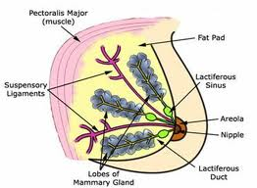
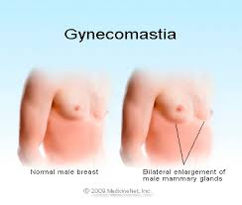
Breast Development
Breast growth is triggered by a precise blend of hormones. Everybody associates estrogen with breast growth, but the fact is, there are four hormones involved in natural breast enlargement:
1) Estrogen
Estrogen is the hormone most responsible for breast growth
2) Progesterone
Progesterone is another important breast enlarging hormone
3) Prolactin
Prolactin is a breast enlarging hormone produced by females during puberty and pregnancy. Prolactin helps develop the mammary glands and increases fat stores in the breasts
4) Growth hormone
Growth hormone triggers the growth of the entire body, including the breasts.
All four hormones are essential to natural breast enlargement.
Falt breast
Femenine breast
Gynecomastia -- Enlarged Breast Tissue not fat in Men

Slide 27
Lactation
Index Finger Is Longer Than Ring Finger – increase E- increase lactation
Ringer Finger Is Longer Than Index Finger – increase T- decrease lactation

Slide 28

Breast Cancer
Increase 2D:4D ratio—increase E --increase cancer breast
high concentrations of estrogen may create a "fertile soil" for cancer to develop later in life
Decrease 2D:4D ratio-increase T –decrease cancer breast

Slide 29
Fibroids And Endometriosis
Increase 2D:4D ratio ---increase estrogen -- increase fibroid and endometriosis

Slide 30
Endometrial And Ovarian Cancer
Increase in 2D:4D ratio ---- increase estrogen - --increase ovarian and endometrial cancer
High 2D:4D ratio may be associated with the earlier onset of breast cancer and higher mortality from breast and ovarian cancers in women

Slide 31
CNS
They say that women with long ring fingers tend to be more aggressive to colleagues and partners and
More likely to pen aggressive letters and to slam the phone down.
They are also more prone to spreading rumours and sulking.
This can lead to divorce

Slide 32
Female Attractiveness
Morphological features such as overall body fat, body fat distribution, as measured by
waist-to-hip ratio ,
breast size, and
hip width
have been proposed to influence female attractiveness and desirability.
Female facial cues and
low BMI
Female figures with slender bodies, low waist-to-hip ratios (a 0.7 WHR) , and large breasts were rated as most attractive, feminine looking, healthy, and desirable for casual and long-term romantic relationships

Slide 33
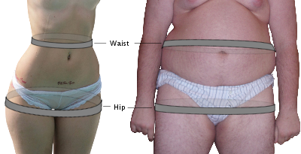
A correlate of maternal levels of testosterone and estrogen is waist:hip ratio (WHR)
Waist–hip ratio or waist-to-hip ratio (WHR) is the ratio of the circumference of the waist to that of the hips.
A WHR of 0.7 for women and 0.9 for men has been shown to correlate strongly with general health and fertility
Hip size indicates pelvic size
Women with low ratios have low testosterone and high estrogen ----- wide pelvis = Normal vaginal delivery
while women with high WHR have high testosterone and low estrogen ----- narrow pelvis = androgenic pelvis = Cesarean delivery
Among girls with identical body weights, those with lower WHRs show earlier pubertal endocrine activity, as measured by high levels of lutenizing hormone (LH) and follicle-stimulating hormone (FSH) as well as sex steroid (estradiol) activity.
Women within the 0.7 range have optimal levels of estrogen and are less susceptible to major diseases such as diabetes, cardiovascular disorders and ovarian cancers
Women with high WHR (0.80 or higher) have significantly lower pregnancy rates than women with lower WHRs (0.70–0.79), independent of their BMIs.
Men with WHRs around 0.9, similarly, have been shown to be more healthy and fertile with less prostate cancer and testicular cancer

Slide 34
Artificial Insemination
Outcome in an artificial insemination program provides evidence for the role of WHR and fecundity
a 0.1 unit increase in WHR decreases the probability of conception per cycle by 30% after adjustment for age, fatness, reasons for artificial insemination, cycle length and regularity, smoking, and parity

Slide 35
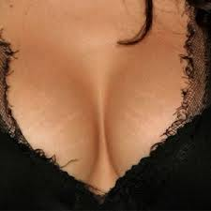
Why are breasts so attractive to men?
Human males tend to be more attracted to women with large breasts because of instinct
Humans are the only Hominids where the breasts remain swollen at all times.
All other Hominids use the buttocks as their sexual attractor. But Humans walk upright and frequently are facing each other--permanently swollen breasts as an alternate sexual attractor. (the general shape of the human breasts is similar to the buttocks: rounded with a cleavage between them)
Larger breasts more closely resemble the shape of the buttocks.
the breasts tend to swell a bit when the woman is ovulating. So, larger breasts also suggest fertility
The subconscious part of a human mind says that the larger the breast is, the more milk it can produce, thus increasing the survival chance of offspring
A man may associate breasts with sex because they are sensitive
a woman is usually taught covering her breasts and privates If a woman shows herself to a man in such ways, it may rouse emotions such as trust and friendship.

Slide 36

Man's attractiveness measured by length of finger
Women are drawn to the telltale signs of high testosterone levels in men –
A symmetrical masculine face,
Wide shoulders,
Narrow hips.
A large male genitals
A deeper voice,
A particular body odour –
who have this more "masculine" finger configuration.

Slide 37
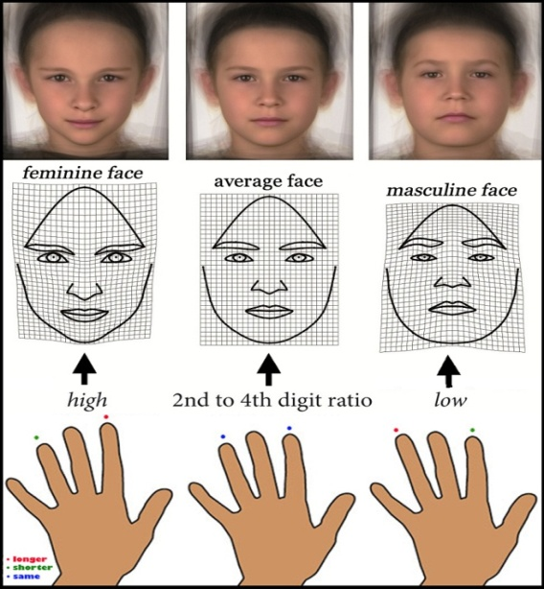
Male facial attractiveness
Increase T –increase male attractiveness of women
Men with lower 2D:4D ratios were also more likely to have more “masculine” features, to have more symmetrical faces, and to be considered attractive by women.

Slide 38
Estimation of Height from the Lengths of Second and Fourth Digits
Height could be predicted
in males with significant assurance from right 2D and left 4D.
In females a different prediction probability was obtained, height be predicted with significant probability only in left 2D

Slide 39
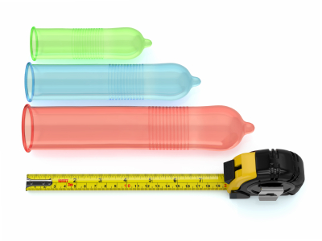
Penis size, men's finger length
Ring Finger Is Longer Than Index Finger – increase T ---increase penis length
These measurements may be too small for the naked eye to notice, but when the researchers compared these finger lengths with penis size, they found the lower the digit ratio, the longer the penis was.

Slide 40

Korean men who were hospitalized for urological surgery at a single tertiary academic centre were examined in this study, and 144 men aged 20 years or older who gave informed consent were prospectively enrolled.
Right-hand second- and fourth-digit lengths were measured by a single investigator prior to measurement of penile length.
Under anaesthesia, flaccid and stretched penile lengths were measured by another investigator who did not measure nor have any the information regarding the digit lengths
stretched penile length = - 9.201 X digit ratio + 20.577
They measured stretched penile length, not erectile penile length. However, many studies have reported a strong correlation between stretched penile length and erectile penile length and shown that stretched penile length provides a reliable estimate of the potential maximal elongation during erection.
Therefore, the technique applied here for stretched penile length measurement is highly recommended for accurate prediction of erect penile length

Slide 41
Orgasm
A larger than average penis
is more likely to bring women
to orgasm

Slide 42
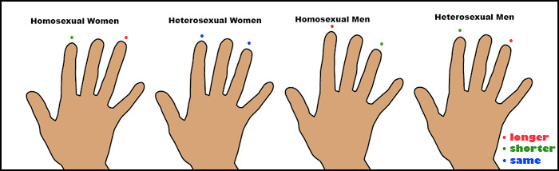
Finger Length And Sexual Preference!
Digit Ratio that a likewise ‘sexually dimporphic trait’ is noticed in the hands
Index fingers of most straight men are shorter than the ring fingers;
Most straight women have the same length or index longer.
Gay men and lesbians tend to have reversed ratio

Slide 43
Gender Sex
Index Finger Is Longer Than ring Finger – decrease T - a man has a small penis then he is more likely to have female children
Ring Finger Is Longer Than Index Finger – increase T --a man has a long penis then he is more likely to have male children

Slide 44

Prostate
Ring Finger Is Longer Than Index Finger –increase T --- increase cancer prostate
Men older than 60 years with an index finger that was longer than their ring finger were 33 percent less likely on average to develop prostate cancer.
Younger men with a longer index finger fared even better, with an 87 percent average reduction in risk

Slide 45
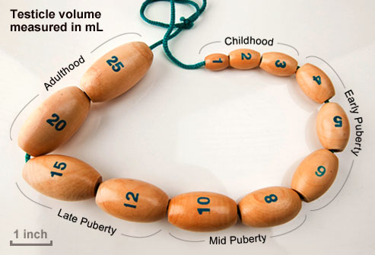
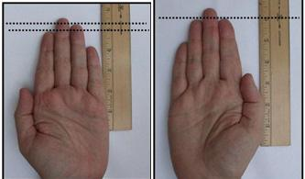
Size of Testis and Function
the importance of fetal androgens in determining reproductive disorders and variation in testis/penis size and sperm count in the ‘normal’ population.
Ring Finger Is Longer Than Index Finger –increase T–- increase testis size – increase function of testis– increase semen parameter ( increase sperm count)
Index Finger Is Longer Than Ring Finger – increase E -- decrease testis size -- – decrease function of testis– decrease semen parameter ( decrease sperm count)
While no significant statistical correlation was found between the digit ratio and the percentages of actively motile sperms and morphologically normal sperms seminal fluid analysis.
It may correlated with functions or disorders of the male reproductive system and the process of spermatogenesis and its outcomes. This is based on the HOXA and HOCD genes common embryological control of finger development and differentiation of the genital bud

Slide 46
Sexual Stimulation
Visual and spatial ability predominate more in the right brain of males as more of their brain becomes devoted to vision-related stimulation.
This explains why men prefer pornography much more than women do for sexual stimulation.
In females, estrogen creates increased neural connections mainly affecting the left brain so that hearing and speech capabilities develop better than they do in males.
Men might see how things are going better than women can, but women listen and hear better.

Slide 47
Digit Ratio (2D:4D) and Romantic Jealousy
Men with higher, more feminine 2D:4D reacted more jealously toward socially dominant rivals.
Women with lower, more masculine 2D:4D reacted more jealously toward physically attractive rivals

Slide 48
Spontaneous Abortion
The ratio of 2nd and 4th digit length (2D:4D) is negatively correlated with spontaneous abortion

